Slide 1
超越学科界限的认知基础 Transdisciplinary Cognitive Foundation
Story Telling about: arrows, analogy, metaphors, symmetry-breaking, and the essence of all stories Week 4
Ben Koo
October 5, 2020

Slide 2

How to Tell a Story?
A Documentary: https://youtu.be/mGGS32kfGKk
Notes:
Whats also refers to Data.

Slide 3
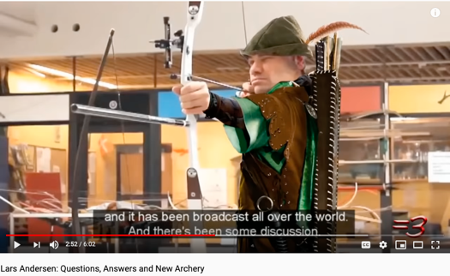

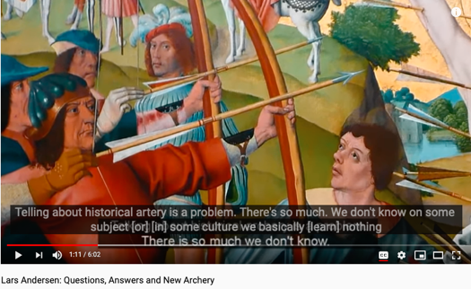
The Story of Moving Arrows (Archery)
A Personality (ies) (Lars Andersen)
The most amazing archer alive (think Robin Hood)
The Technology (Bows and Arrows)
The archer’s Paradox (science and wizardry)
Institutional/Societal Contexts
How does the society and institutional backdrop influence the practice of arrow shooting?
Notes:
Whats also refers to Data.

Slide 4
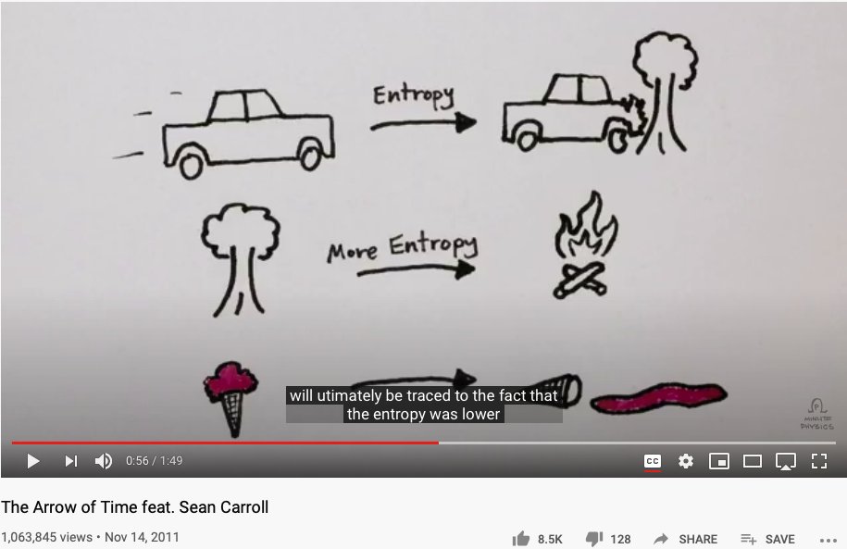
The Arrow of Time
Notes:
Whats also refers to Data.

Slide 5
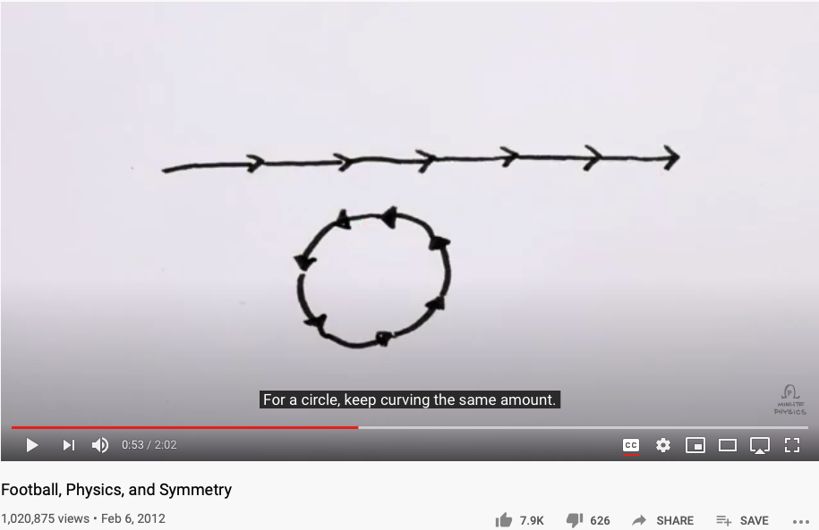
Arrows are about Symmetry-Breaking
Notes:
Whats also refers to Data.

Slide 6

Splitting the Arrow
Image Source: https://tvtropes.org/pmwiki/pmwiki.php/Main/SplittingTheArrow
Notes:
Whats also refers to Data.

Slide 7
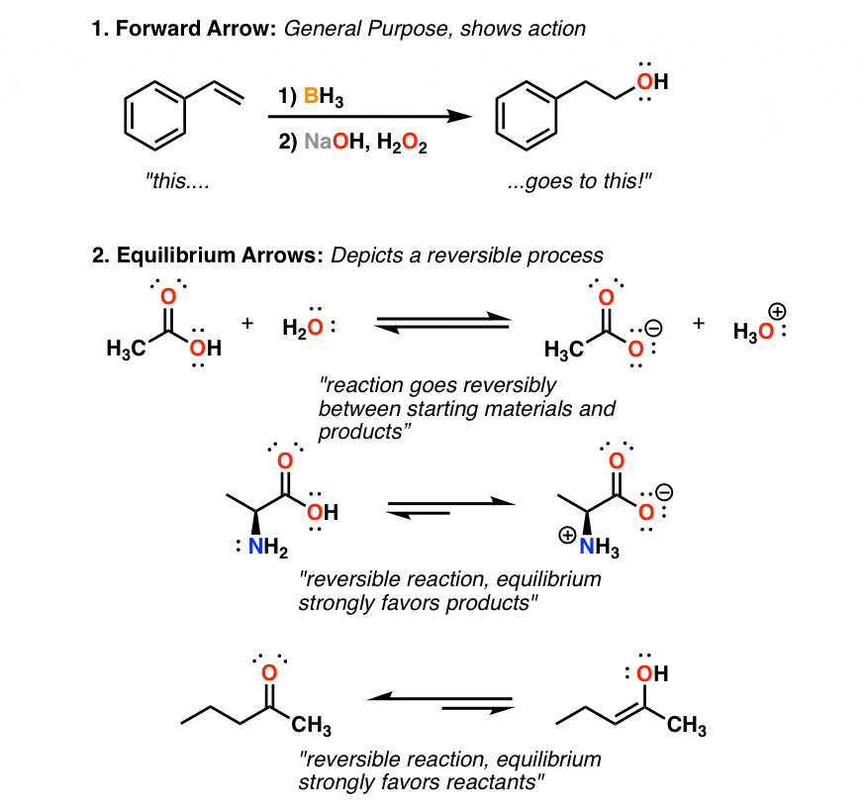
8 Types of Arrows in Organic Chemistry
Notes:
Whats also refers to Data.

Slide 8
Glossary
Terms related to Story Telling: analogies, metaphors, symmetry-breaking
Category Theory/范畴论: A foundation of all logic and mathematics
Morphisms态射(Functions/Functors 函子/Natural Transformation自然转换): The only types of building blocks of Category Theory.
Analogies (metaphors): The fundamental building block of cognitive activities
Symmetry/Symmetry-Breaking, compression: The essence of analogies/morphisms.
Contextualization, Orientation, Measurement Units: The core elements in practical namespaces

Slide 9
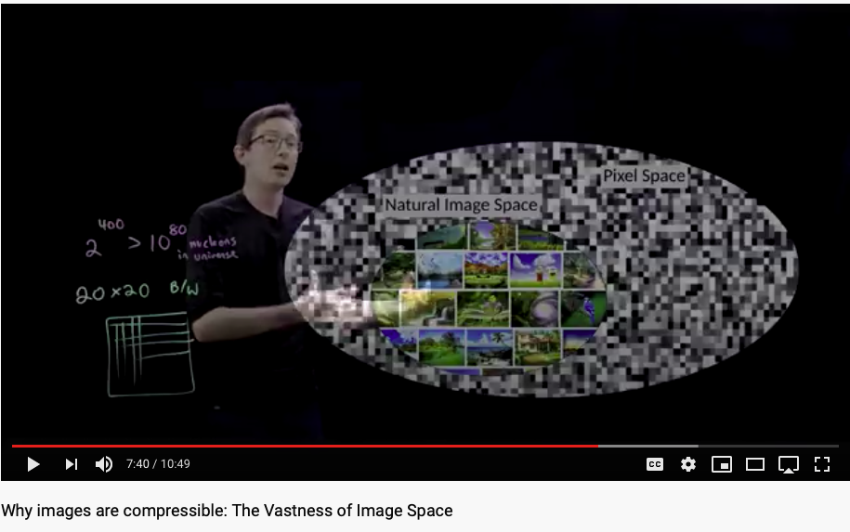
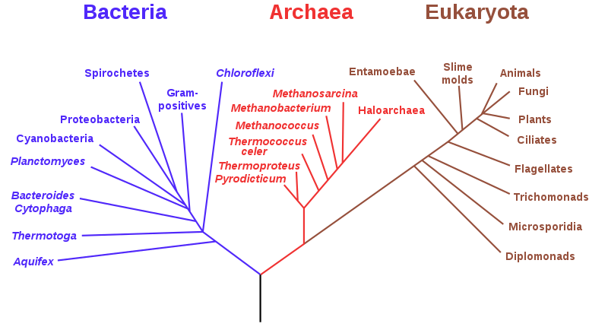
Can Monkeys tell a Shakespearean Story?
Think of natural images encoded in various trees just like DNA.

Slide 10
What is Transdisciplinary?
“transdisciplinarity represents the capable germ to promote an endogenous development of the evolutionary spirit of internal critical consciousness, where religion and science are complementary. Respect, solidarity and cooperation should be global standards for the entire human development with no boundaries. This requires a radical change in the ontological models of sustainable development, global education and world-society. We must rely on the recognition of a plurality of models, cultures and socio-economical diversification. As well as biodiversity is the way for the emergence of new species, cultural diversity represents the creative potential of world-society.”
Transdisciplinary Education as Ethic of the Diversity Reform in the World-Society of the 21st Century, article published by Javier Collado on June 20th: World Refugee Day in Global Education Magazine, ISSN 2255-033X

Slide 11

Why Transdisciplinary?
A foundation for reasoning
A unifying cognitive foundation cannot be separated by domain expertise
What and Why must be unified
Story telling reveals why through whats
The “whats” contextualize causation
Story telling, or a narrative, explains why
Any chosen narrative, embodies the causation through out its story composition, which links all the whats as collateral evidence to signify why.
Notes:
Whats also refers to Data.

Slide 12
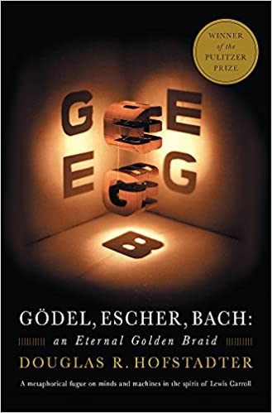


Metaphors and Story Telling

Slide 13
The Science of Story Boarding
The Soundness and Completeness of Story Plots
Is there a way to ensure the rigour of story construction?
The Operational Aspect of Story Telling
What are the process/tooling supports of Story Telling? (DevOps/CICD)?
The Historical Lineage of Story Telling
How to avoid name/story collision in story construction, presentation?

Slide 14
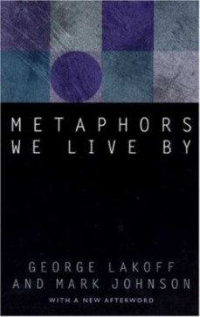

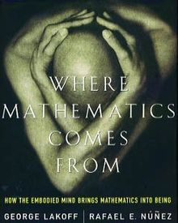
Metaphors as a Cognitive Foundation

Slide 15

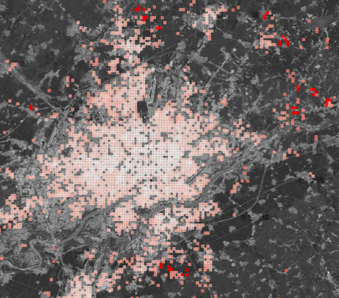
A Metaphor in Space http://ghostcities.mit.edu/
Prof. Sarah Williams of MIT Urban Planning Department

Slide 16
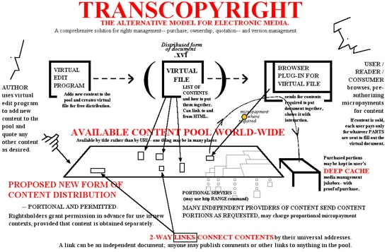
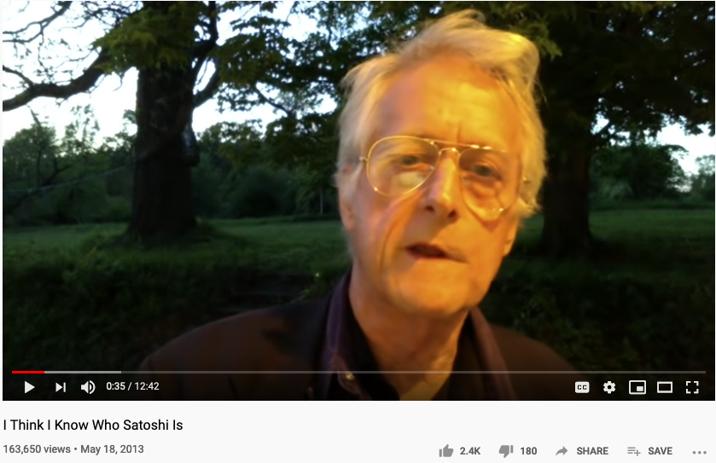
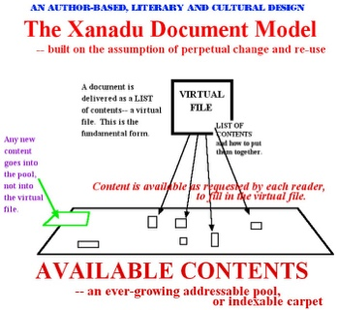
The Grand Daddy of Hypertext
Nelsdon thinks Nakamoto is: Shinichi Mochizuki
Ted Nelson in 2013:
https://youtu.be/emDJTGTrEm0?t=474
Ted Nelson’s Hypertext

Slide 17

A Metaphor in Networked Documents
See Lo and Behold, the interview with Ted Nelson, Creator of Xanadu

Slide 18

Story Telling in a Workflow
Character Placement
Contextualization and Story Boarding
Order, Proportion and Proportionality
Promotion
Delivery

Slide 19
Contextualization and Story Boarding
Present a spacetime location
Present a spacetime location of event occurence
Story Boarding: (Event occurrence)
Make sure the storyline follows a consistent temporal logic
Closing the loop
Make sure that the story board resonate with the main thesis of the intentional message.

Slide 20
Character Design
Character Placement
Identify complementary roles to accentuate the unique nature of each part
Proper selection of roles may achieve best information compression.
Think about eigen values and eigen matrices
Assign right names to parts (通过命名加强人物角色设定）
Only involve relevant characters, and pick names that implicate their purposes in the plot

Slide 21
The “right” part out of a gazillion parts?
Can we leverage the historical data exemplified by the natural/biological wisdom on earth?

Slide 22
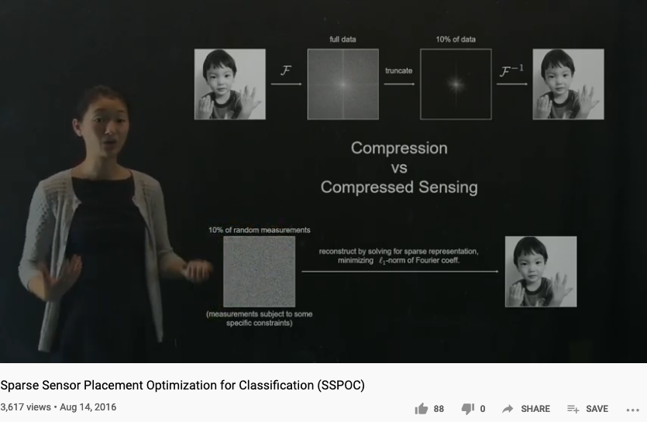
Compression Algorithms can help

Slide 23

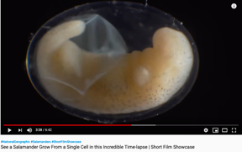
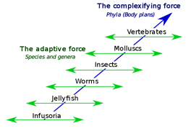
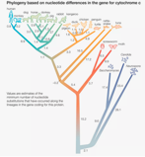
The Four Central Questions
Where to find natural/biological wisdom?
Causation | Ontogeny
Adaptation | Phylogeny

Slide 25
Ontogeny and Phylogeny as Strategies for NsM?
Ontogeny is the developmental history of an organism within its own lifetime, as distinct from Phylogeny, which studies the evolution of a species.
Phylogeny is the study of relationships among different groups of organisms and their evolutionary development.
Phylogeny and taxonomy are two systems for classifying organisms in systematic biology. While the goal of phylogeny is to reconstruct the evolutionary tree of life, taxonomy uses a hierarchical format to classify, name, and identify organisms.

Slide 26
Order, Proportion and Proportionality
Orders in time, in scale, and in proportions
Construct stories in abstract structures, such as Partially Ordered Sets (POS)
Organize story content in terms of temporal order, complexity scale, and relative proportions
Proportions between strategic elements in the story
Allocate the amount of resources to the story plot development in “balanced” proportions
Proportionality
Choosing a set of measurment units. (Natural Units, Metric/English Units, Computing Units)

Slide 27
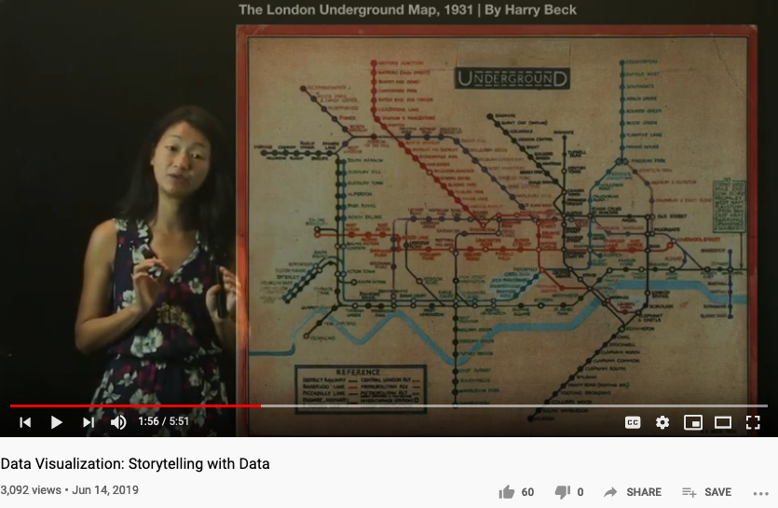
Order in time, sequences, locations

Slide 28
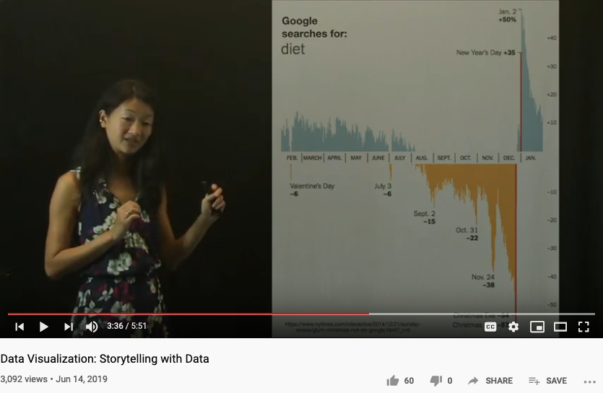
Proportion between key elements

Slide 29
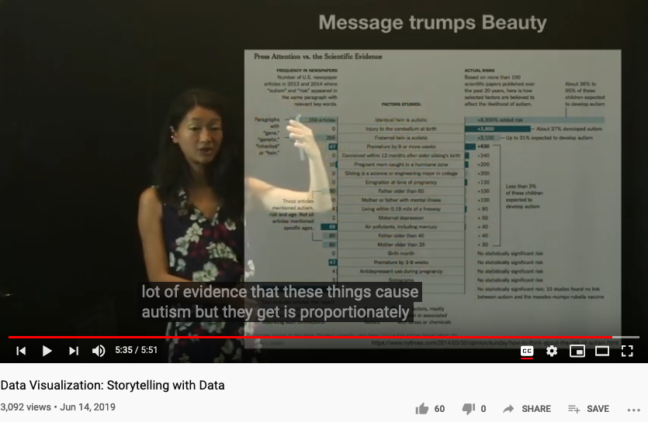
Measures and Proportionality

Slide 30
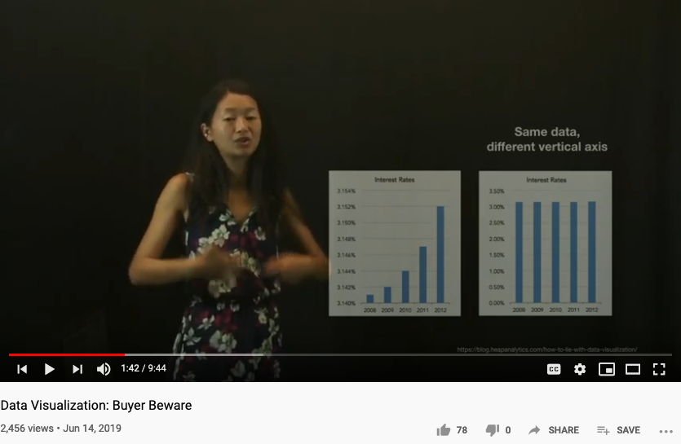
Buyers be aware!

Slide 31
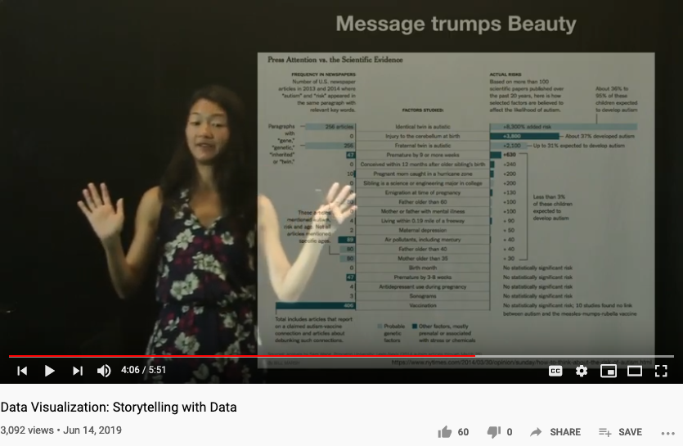
Message Trumps Beauty!

Slide 32
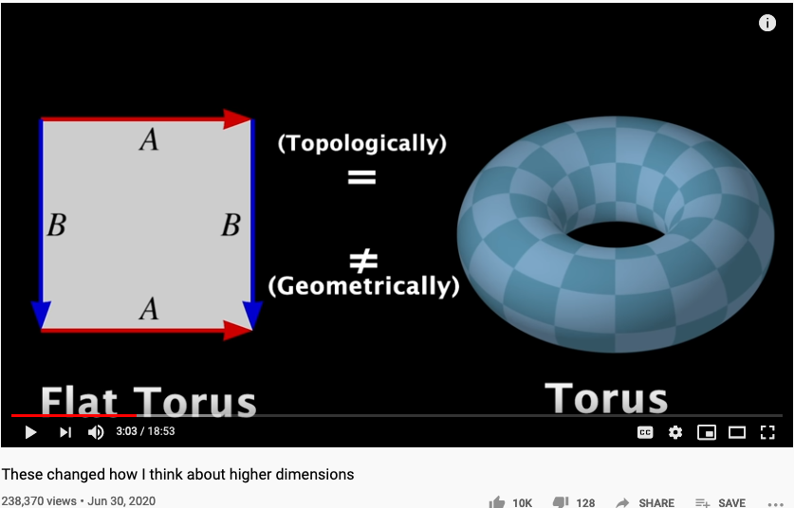
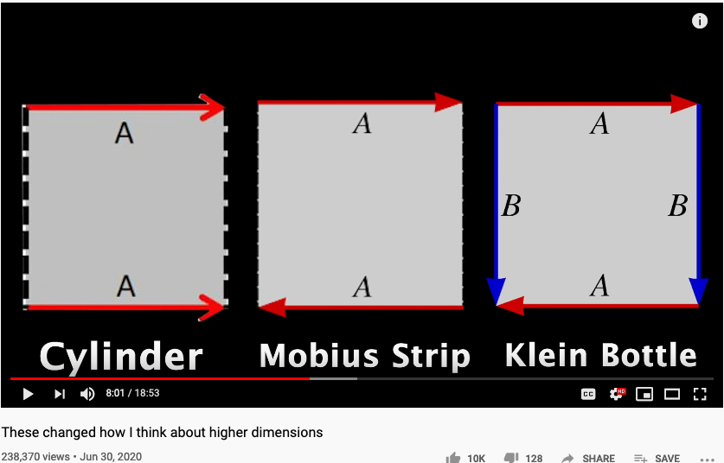
Higher Dimensional Structure denoted by Arrows
https://youtu.be/lmcT2mP2bfE?t=183
https://youtu.be/lmcT2mP2bfE?t=481

Slide 33
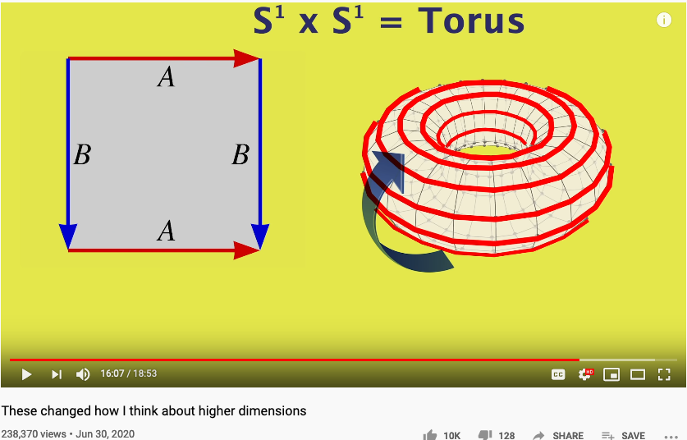
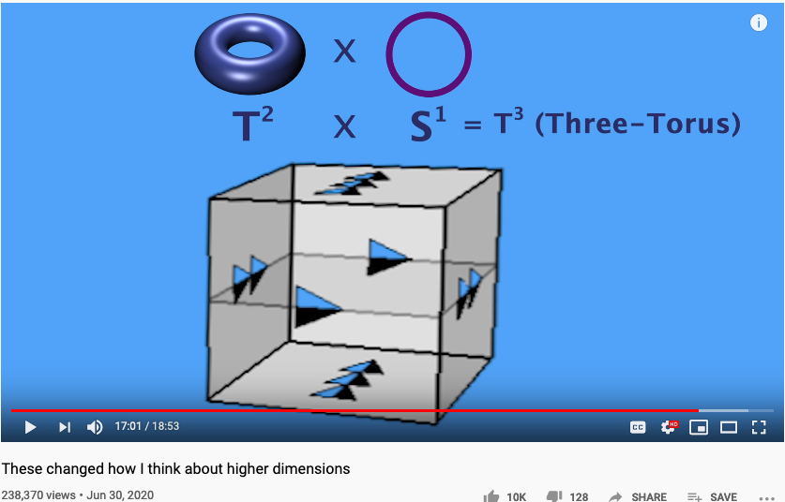
The Idea of Multiplication expressed in Arrows
https://youtu.be/lmcT2mP2bfE?t=967
https://youtu.be/lmcT2mP2bfE?t=1021

Slide 34
The World According to Category Theory
Find an image that shows arrow that
points to another arrow
A mathematical foundation based on one notation: arrow!
Also known as the arrow chasing computation.

Slide 35
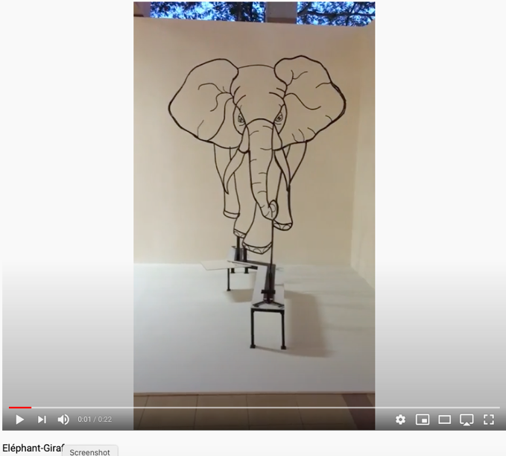
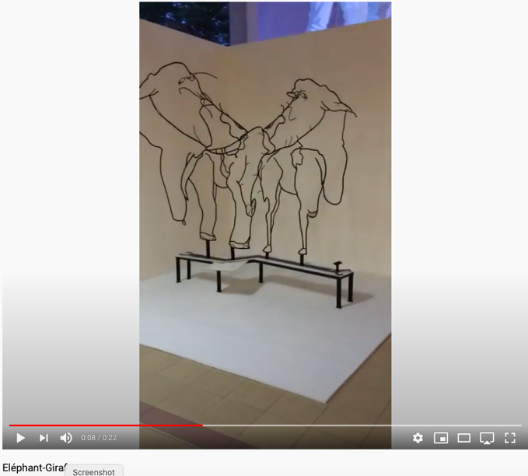
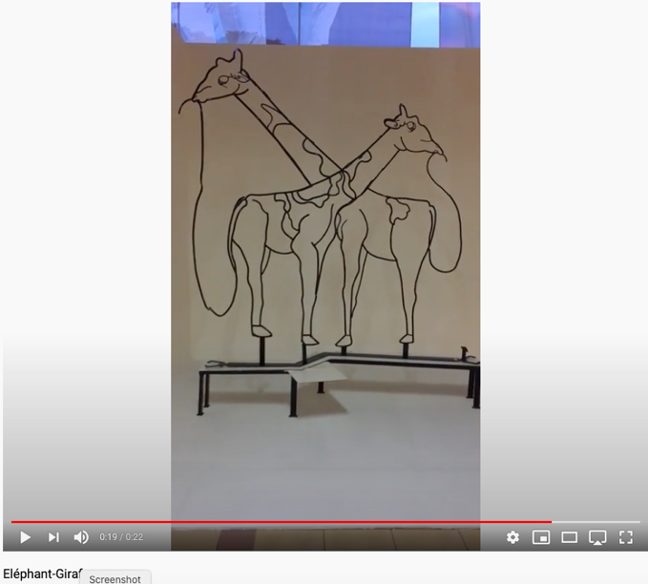
Perspectives of Category Theorists (Yoneda Perspective)
Yoneda lemma implies:
all vantage points give all information.
- excerpt from Math3ma

Slide 36
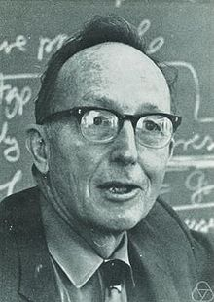
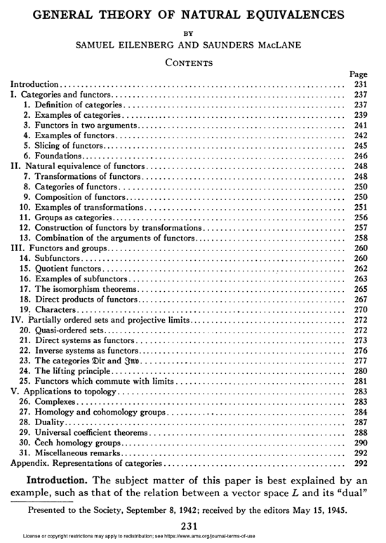
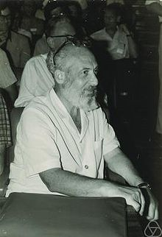
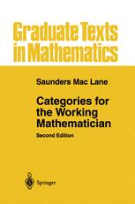
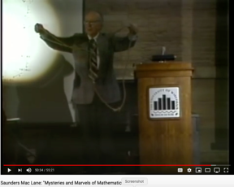
A General Theory of Natural Equivalences
Mac Lane and Eilenburg founded Category Theory with this paper.

Slide 37

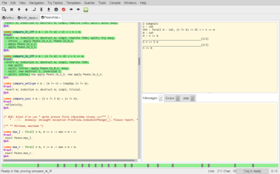


Universal Constructs
The most general possible way to name things consistently!
Coq:
Interactive Proof Assistant
Based on Univalence Foundations and the Coq Proof assistant, Voevodsky created a path to organize mathematical knowledge in a computable language based on ”Higher Category Theory”, also known as Homotopy Type Theory.

Slide 38
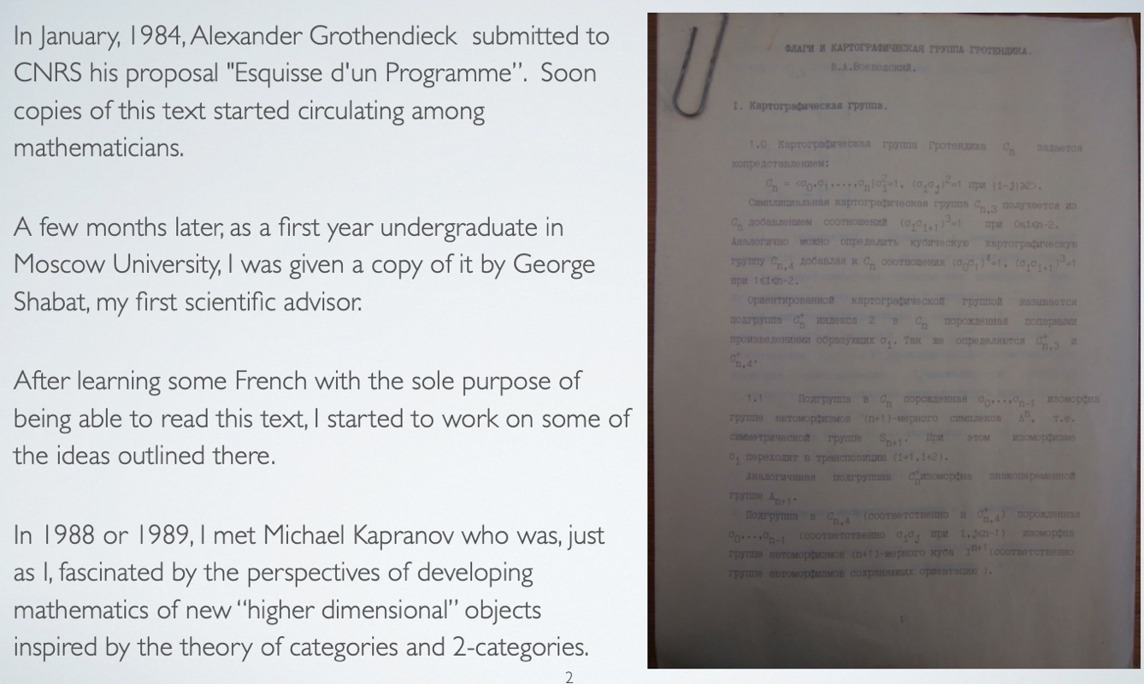
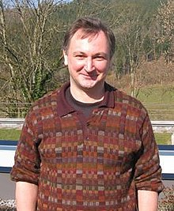
The Story behind Univalent Foundation and its roots in Category Theory
Voevodsky in 2011
Image Source: Wikipedia

Slide 39
The Idea of Universality
“Best Approximation” possible,
up to Isomorphism
Sometimes called equivalence up to isomorphism

Slide 40
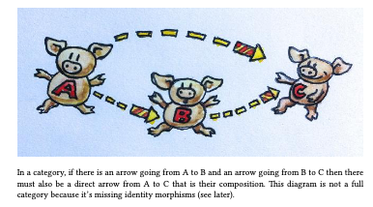
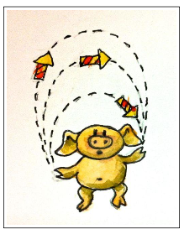
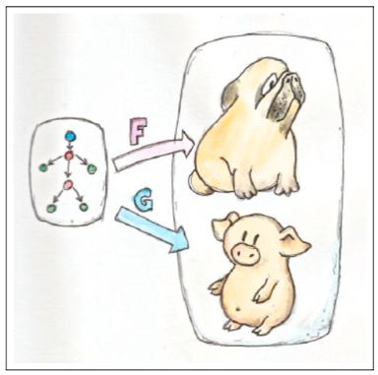
Arrows as Universal Building Blocks
If it looks like a pig, walks like a pig, and taste like a pig, it is a pig.

Slide 41



















Three Kinds of Arrows
安全素养来自可分析、可聚合的思维基础，三层次的认知和范畴论中的类比与函数具有对应关系
1.函数 (Function)
$$A \underset{→}{ f } B$$
$$A$$
Object / Set $A$
Category $S$
A function $f$ from set $A$ to set $B$
2.函子 (Functor)
$$S$$
$$\underset{→}{ F }$$
$$T$$
$$A \underset{→}{ f } B$$
$$C \underset{→}{ g } D$$
A functor $F$ from category $S$ to category $T$
$$S \underset{→}{ F } T$$
Functor $F$
$$F$$
3.自然转换 (Natural Transformation)
Natural transformation compares a parallel pair
$$S$$
$$T$$
$$F \underset{→}{ η } G$$
$$η$$
Natural Transformation $η$
$$G$$

Slide 42
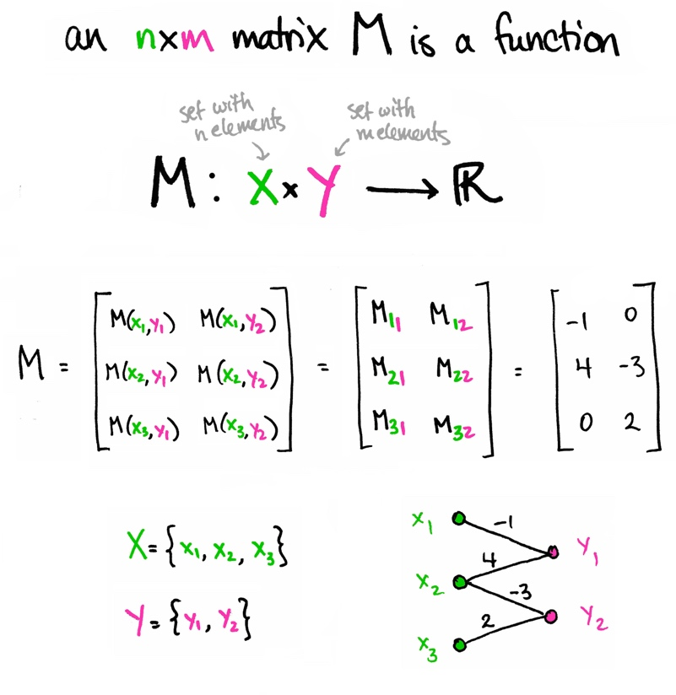
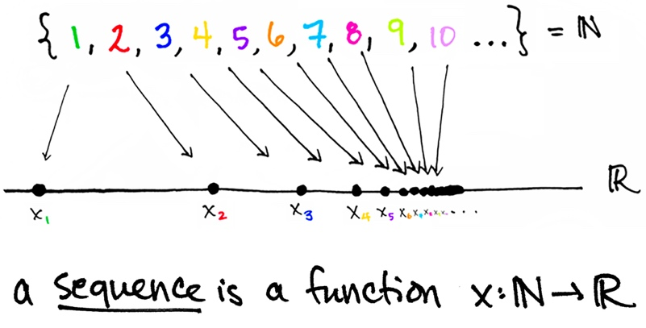

Arrow = Function = Morphism
Functors: Structure preserving morphisms (functions)
Image Source from: https://www.math3ma.com

Slide 43
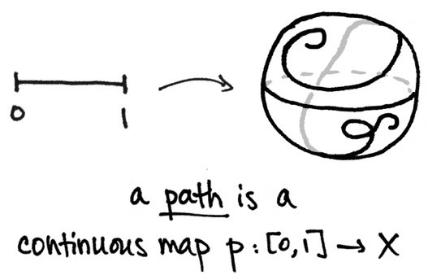
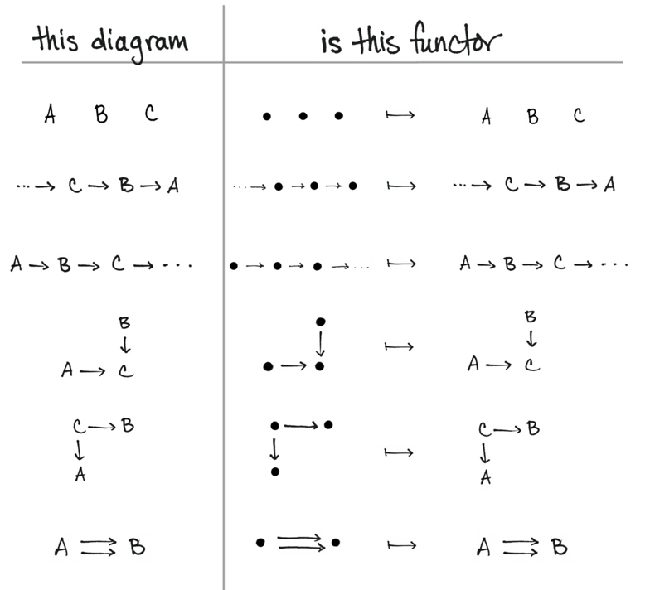
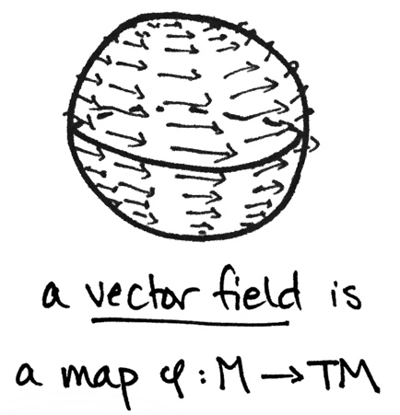
Functors are “Maps”
Functors: Structure preserving morphisms (functions)
Image Source from: https://www.math3ma.com
What is a Functor? Part I , Part II

Slide 44
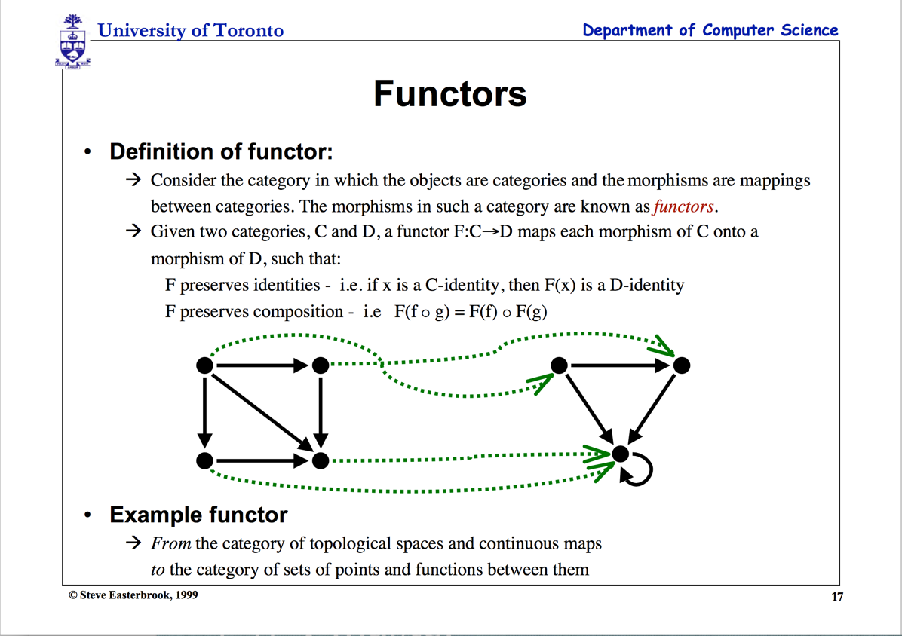

Slide 45
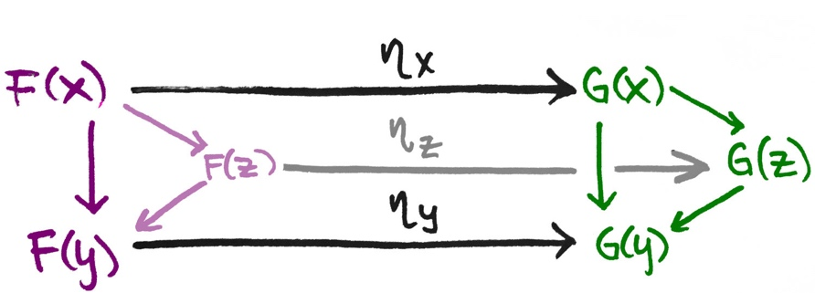
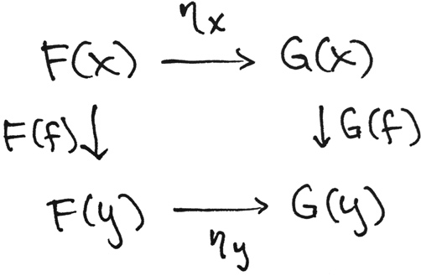
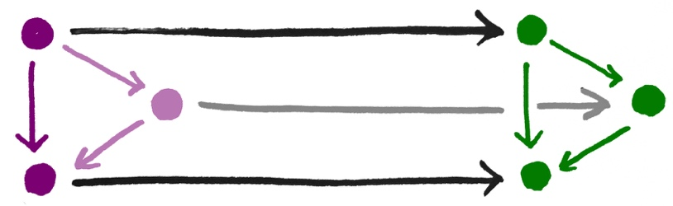

Natural Transformation “relates” Functors
Given two Functors F and G
Image Source from: https://www.math3ma.com
What is a Natural Transformation?

Slide 46
Category Theory: Unary Computation
How to do computation with only one symbol?
Verbs and Nouns are the same type!
Operators and Operands are “Terms” (Names)

Slide 47
The Categorical Lens into a Set
It is Forbidden to look into any ”object”.
All properties must be inferred from arrows!
The cardinality of a set
can only be
studied through counting arrows.

Slide 48

Category Theory and Type Theory

Slide 49

Verticle Composition
Page. 175 of Category Theory for Programmers

Slide 50

Horizontal Composition
Page. 176 of Category Theory for Programmers

Slide 51













Computing Architectures associated with Tools
Abstract Specification
Cloud Computing
Deterministic
Probabilistic
Centralized
Hybrid
Distributed
Single/Multi Core
Many Core
Single Site
Multi Site
Many Site
Hackerspaces
Super Computing Center
Notes:
51

Slide 52


Universal Constructions as a “uniquing” strategy

Slide 53


Limits and Co-Limits
Image Source from: https://www.math3ma.com

Slide 54




What is Monad
A Monad is the minimal amount of structure needed to overload function composition in a way that “performs an extra computation” on the intermediate value.
- Youtuber Shelljump
An additional stage, known as Kleisli Category of computational indirection, infuses significant flexibility in function composition.

Slide 55



Kleisli Arrow of outrageous Fortune

Slide 56
Yoneda Lemma
1. Idea
The Yoneda lemma says that the set of morphisms from a representable presheaf y(c) into an arbitrary presheaf X is in natural bijection with the set X(c) assigned by X to the representing object c.
The Yoneda lemma is an elementary but deep and central result in category theory and in particular in sheaf and topos theory. It is essential background behind the central concepts of representable functors, universal constructions, and universal elements.
-excerpt from nLab

Slide 57

Mathematical Models:
A Sketch for the Philosophy of Math (1981)
The Lower part of the Table 1 of the paper
http://links.jstor.org/sici?sici=0002-9890%28198108%2F09%2988%3A7%3C462%3AMMASFT%3E2.0.CO%3B2-D
Notes:
Category theory has become an important role in contemporary mathematics and theoretical computer science.

Slide 58
Mathematical Models:
A Sketch for the Philosophy of Math (1981)
Mathematics begins with puzzles and problems dealing with combinatoric and symbolic aspects of the general human experience. Some of these aspects turn out to be systematic and intrinsic, rather than arbitrary and tied to one context. … These observations can be described as starting with a variety of human activities, each one of which leads more or less directly to a corresponding portion of mathematics:
Counting | Arithmetic, Number Theory
Measuring | Real Numbers, Calculus, Analysis
Shaping | Geometry, Topology
Forming | Symmetry, Group Theory
Estimating | Probability, Measure Theory
Moving | Mechanics, Calculus, Dynamics
Calculating | Algebra, Numerical Analysis
Proving | Logic
Puzzling | Combinatorics, Numer Theory
Grouping | Set Theory, Combinatorics
http://links.jstor.org/sici?sici=0002-9890%28198108%2F09%2988%3A7%3C462%3AMMASFT%3E2.0.CO%3B2-D
Notes:
Category theory has become an important role in contemporary mathematics and theoretical computer science.

Slide 59

Category Theory is the Mathematics of networks
John Baez
Based on Marquis, Jean-Pierre on Stanford Encyclopedia of Philosophy**: “Category theory has become an important role in contemporary mathematics and theoretical computer science. It is a powerful language, or conceptual framework, allowing us to see the universal components of a family of structures of a given kind, and how structures of different kinds are interrelated”
Source: *John Baez’s Stuff, http://math.ucr.edu/home/baez/
**Jean-Pierre Marquis, https://plato.stanford.edu/archives/win2015/entries/categorytheory/
Notes:
Category theory has become an important role in contemporary mathematics and theoretical computer science.

Slide 60
范畴论: 不需要数字的计算方法（基于箭头的算术）
A Category is a diagram composed of Objects and Arrows
构成
B
f
g
h
A
C
案例: 由三个对象 (A,B,C) 和两个箭头(f, g)所构成的范畴
“Category Theory is a graph with a rule for composing arrows (f,g) head to tail to give another arrow (h)。”
M. Barr, and C. Wells, Category theory for computing science. 1990. 21.

Slide 61
Formal Definition of Category Theory
所有的范畴必须满足以下条件：
id_{B}
B
f
g
A
C
id_{A}
id_{C}
由箭头与箭头所指的对象所构成
每一个对象X 必然有一个自指的箭头 id_{X}
首尾相连接的箭头可以“构成”（compose）新的箭头

Slide 62
Category Theory is about composing Arrows
下列两个箭头( f, g ) 可被构成/聚合 (composed ) 为一个箭头 h
B
f
g
A
h
C
范畴论的符号系统是用来展现函数/函子/自然转换的可聚合性（composability）

Slide 63

Universal Morphism
The most important definition in category theory: Universal Property

Slide 64
Compute by Arrow Chasing
B
B
Always implies:
f and g can be
composed into
h
where
h = g ◦ f
f
g
f
g
A
h
C
h = g ◦ f
A
C
Functional Composition
h = g ◦ f

Slide 65
Measurement results come from:
comparison/symmetry-breaking

Slide 66


Functor in Action
https://youtu.be/XcM39gnqgNc?t=155
https://youtu.be/YLIH8TKbAh4?t=389

Slide 67



Various ways to interpret Natural Transformation
Think about Natural Transformations as various kinds of Abstract Interpretations?

Slide 68

ALL Concepts can be represented using Kan Extension
A highly useful mathematical construct for teaching and learning abstractions.

Slide 69

Multiplication

Slide 70

Addition

Slide 71





Functional Composition
Decomposition
C
C ^{OP}
3D printing
3D printing
g
F ^{op}
f
f ⁻¹
g ⁻¹
2D printing
1D movement
(Opposite Functor)
2D printing
1D movement

Slide 72









函数对等性与交换律(Commutativity)
两条首尾对象相同的路径表示:两套函数 (morphisms) 可对等交换 “commutes”
h = g ◦ f
$$\underset{→}{ f }$$
$$\underset{→}{ g }$$
The crucial aspect of a category is that
two appropriately compatible arrows can
be combined (by composition ) to form a third
arrow.
$$\underset{→}{ h }$$
$$\underset{→}{ f }$$
q ◦ k = g ◦ f
$$\underset{→}{ k }$$
$$\underset{→}{ g }$$
$$\underset{→}{ q }$$

Slide 73


Any ordered system，can be represented by Arrows

Slide 74
Workflow or product systems in Arrowed Structures
Initial Idea
Identify Customer Needs
Establishing technical specification
Initial Idea
Collecting competitive benchmarking
Identify Opportunities
List of Customer Needs
List of Opportunities
Reflect on the result and the process
Evaluate and Prioritize Project
Establish the relative importance
Reflect on the result and the process
Filtered Opportunities
Filtered Customer Needs
Allocate Pre-project Planning
Interpret raw data in terms of customer need
Project Idea
Customer Needs Raw Data
Gathering Raw Data
Re-evaluate Result and Process

Slide 75
(Following from Previous page)
Target Specification
Concept Generation
Establishing technical specification
Final Product Concept
List of Metric Specifications
Measuring & interpreting concept
Reflect the result and the process
Collecting competitive benchmarking
List of Survey Result
Surveying concept
Competitive Evaluation List
List of Concept Scoring
Set Ideal marginal value
Scoring
Re-evaluate screening
Re-evaluate Result and Process
Target Specification List
List of Concept Screening
Screening
List of Concept Generation
Determining concept generation

Slide 76

The Commonalities of these different characters?
Notes:
Nespresso borrowed the insights from Hp, basically “If selling replacements is succesful then we have to focus on the replacements to succeed”
Borrowing experiences across industries to overcome Industry Barriers and failing one and again with the same complex problems.

Slide 77







Product Design by “Analogy”
C
F (Functor)
g
h
Maps similar structures across categories
h·g
F (Functor)
D
Think different, yet the same!
Notes:
Nespresso borrowed the insights from Hp, basically “If selling replacements is succesful then we have to focus on the replacements to succeed”
Borrowing experiences across industries to overcome Industry Barriers and failing one and again with the same complex problems.

Slide 78






Would simple “analogy” always work?
Development Process
g
h
C’
F
h·g
F (Functor)
αG
C’’
Category Company C
F’ (Functor)
?
?
C’’’
Notes:
Nespresso borrowed the insights from Hp, basically “If selling replacements is succesful then we have to focus on the replacements to succeed”
Borrowing experiences across industries to overcome Industry Barriers and failing one and again with the same complex problems.

Slide 79




Juicero Case
What happened?
120M USD
Doug Evans
Notes:
Initial idea:
Innovative small press could change the juicing industry.
Identify Customer Needs:
Customers need juice or a press?
Customers need fast and clean juice making
Smart phone app to monitor their diet
Target Specification:
Thousands of pounds on 200 cm² surface press
Home appliance or Businesses?
Producing a juice in <90 s
Concept Generation:
Over engineered (24 pieces for the lock door system).
Cold pressured
QR scan to apply the exact pressure.
-----------------------------------------------------------------------------------------------

Slide 80





Juicero by borrowing “Analogies”
Company
Development Process
Promotion Channel
F
h
f
αG
Natural transformation
h
G
g
i
H
Notes:
Nespresso borrowed the insights from Hp, basically “If selling replacements is succesful then we have to focus on the replacements to succeed”
Borrowing experiences across industries to overcome Industry Barriers and failing one and again with the same complex problems.

Slide 81


Juicero as a Textbook Case Study
Notes:
Nespresso borrowed the insights from Hp, basically “If selling replacements is succesful then we have to focus on the replacements to succeed”
Borrowing experiences across industries to overcome Industry Barriers and failing one and again with the same complex problems.

Slide 82

Tell a Story the Silicon Valley Style
Notes:
Nespresso borrowed the insights from Hp, basically “If selling replacements is succesful then we have to focus on the replacements to succeed”
Borrowing experiences across industries to overcome Industry Barriers and failing one and again with the same complex problems.

Slide 83
Conflicts/Branches/Intersections that don’t exist in Higher Dimensions

Slide 84


Counter Arguments in Higher Dimensions (intersection will not occur in Higher Dimensions)
https://youtu.be/lmcT2mP2bfE?t=551
https://youtu.be/lmcT2mP2bfE?t=579

Slide 85


范畴论可简化复杂的计算过程
Represents ONLY SOME possible trajectories to the moon
NKS 2004, MIT A New Kind of Language for Complex Engineering Systems
Case Study: NASA’s Apollo Program Benjamin Koo
Edward F. Crawley

Slide 86
完全没有算数逻辑的学科，不便成为科学！

Slide 87
外部因素：描述会 渗透/穿透 “运营背景” 边界的关键因素
抽象规范
运营背景：包括宏观/中观/微观时空场域的常用“标签”
目标：以在特定场域中达到欲求效果的 一个项目/函数/箭头 统一标签的别名
效果检验：为了达成目标的输出效果与输入资源的检验条件
输出结果：
可被统一的时间标签与命名空间联系的数据结果
具体实现过程
项目或函数的实现过程/算法细节
每一个实现过程与算法也可以被统一的标签来命名
输入资源：
可被统一的时间标签与命名空间联系的数据结果

Slide 88
认知技能来自隐喻
本体隐喻：脑中的概念与实体世界的联系
已熟悉的词汇 （如桌椅、门窗、飞禽走兽。。。）
空间隐喻：各物品或概念单元的时空定位关系
物件中的上下左右、事件发生的前后（偏序关系）
社会地位、亲属联系的高低大小关系
系统隐喻：整套物品（事件）的结构类似性
机器人对应与木流牛马
计算机的作业系统对应与国家的宪章

Slide 89
不论群体或是个人的“认知”都可用隐喻来解释
认知科学 | 数学（范畴论） | 社会学
本体隐喻 | 集合中的元素、特定的数值（0、1、3、e、pi、), 代数符号 （x、y、z）、 | 已知概念（数字、机构、指标、货币、。。。）
空间隐喻 | 数值之间的对应关系，（函數 Function) | 历史关系、合作关系 （产业链上下游关系），竞争关系
系统隐喻 | 不同範疇（Category）之間的結構對應关系（函子，Functor） | 知识地图、战略地图、产业或知识体系的演进过程（过程本身当作一种新旧之间的联系）

Slide 90

本体比喻 (Ontological Metaphor)
https://www.youtube.com/watch?v=acHxwB88dxk&t=99s

Slide 91

空间比喻 (Orientation Metaphor)
Audio-visual metaphors of the financial crisis: meaning making and the flow of experience
http://www.scielo.br/scielo.php?script=sci_arttext&pid=S1984-63982015000200311

Slide 92

系统比喻 （System Metaphor)
http://www.eoht.info/page/Analogy

Slide 93


Category Theory was invented to compare “Analogies”
Let’s see the example :
Functor
Category
Natural Transformation
Source : Milewski, 2015

Slide 94
Construct Story Telling using Metaphorical Connections
 | Story Telling | Metaphors | Categorical Arrows
Dynamics | Story Plot | Types of Outlines | Natural Transformation
Compositional Laws | Morals of the Story | Existing Stories | Functor/Structure Preservation
Building Blocks (BB) | Spacetime Context and the Characters | Names of the BB | Functions/Morphisms/Objects

Slide 95



Kuhn’s Cycle
https://www.thwink.org/sustain/glossary/KuhnCycle.htm

Slide 96

关键词：Incommensurability （不可通约）
http://plato.stanford.edu/entries/incommensurability/
产业创新导致行为“范式”的转移
Paradigm shift (范式转移）
传统产业的范式，不再适用于新的社会环境
http://foodtank.com/news/2015/01/five-ways-cell-phones-are-changing-agriculture-in-africa

Slide 97

Symmetries and Arrows
Image source: https://youtu.be/pt0aorJvKVg?t=53

Slide 98
隐喻的分类：本体／空间／系统 Metaphors are Symmetries in Meaning
本体隐喻：脑中的概念与实体世界的联系
已熟悉的词汇 （如桌椅、门窗、飞禽走兽。。。）
空间隐喻：各物品或概念单元的时空定位关系
物件中的上下左右、事件发生的前后（偏序关系）
社会地位、亲属联系的高低大小关系
系统隐喻：整套物品（事件）的结构类似性
机器人对应与木流牛马
计算机的作业系统对应与国家的宪章

Slide 99


管理本体隐喻：管理MediaWiki词汇

Slide 100
Mathematical Models: A Sketch for the Philosophy of Math (1981)
Saunders Mac Lane从数学文献中所总结出的各种动词片语
Counting | Arithmetic, Number Theory
Measuring （度量） | Real Numbers, Calculus, Analysis
Shaping （分辨形体） | Geometry, Topology
Forming （成形） | Symmetry, Group Theory
Estimating （估测） | Probability, Measure Theory
Moving （移动） | Mechanics, Calculus, Dynamics
Calculating （计算） | Algebra, Numerical Analysis
Proving （证明） | Logic
Puzzling （解谜、加密） | Combinatorics, Number Theory
Grouping （聚类） | Set Theory, Combinatorics
http://links.jstor.org/sici?sici=0002-9890%28198108%2F09%2988%3A7%3C462%3AMMASFT%3E2.0.CO%3B2-D
Notes:
Category theory has become an important role in contemporary mathematics and theoretical computer science.

Slide 101
Carlo Rovelli的 Ontological Map of Space-Time
Covariant Loop Quantum Gravity: An Elementary Introduction of Quantum Gravity Theory and Spinfoam Theory
by Rovelli and Vidotto

Slide 102
知识图谱：Ontological Engineering
Ontology engineering … studies the methods and
methodologies for building ontologies:
… formal representations of a set of concepts
… Core ideas and objectives of ontology engineering
are also central in conceptual modeling.
https://en.wikipedia.org/wiki/Ontology_engineering

Slide 103


可计算图：Computable Diagrams

Slide 104
词汇的比较 （Saunders Mac Lane vs. Modelica）
Counting | Arithmetic, Number Theory
Measuring （度量） | Real Numbers, Calculus, Analysis
Shaping （分辨形体） | Geometry, Topology
Forming （成形） | Symmetry, Group Theory
Estimating （估测） | Probability, Measure Theory
Moving （移动） | Mechanics, Calculus, Dynamics
Calculating （计算） | Algebra, Numerical Analysis
Proving （证明） | Logic
Puzzling （解谜、加密） | Combinatorics, Number Theory
Grouping （聚类） | Set Theory, Combinatorics

Slide 105


可计算图形语意：Computable Semantics

Slide 106

Sensor Placement and Data Collection

Slide 107
How Category Theory Simplifies Product Development
For a start-up, there are two possible outcomes which define two maneuvers, one reversible:
Succeed after a process, advance
Failed after a process, repeat, roll back [opposite from advance]
Repeat
Identify customer needs and problems
Advance
Advance (R&D)
Repeat
Roll Back
Roll Back
Repeat
Target specification and proof of concept
Roll Back
Development techniques / framework
Advance

Slide 108
How Category Theory Simplifies System Development
Can be simplified as :
A
B
Domain
Codomain
Data Gathering
Data Specifications
Identity Functor
Identity Functor
Eevery connection is reversible
Codomain
Domain
Infinite possibilities!!!
Find the viable paths to succeed!
Notes:
Identity functor

Slide 109


Slide 110


Slide 111


数学化的概念 Conceptual Mathematics
Authors:
William Lawvere
Stephen Schanuel

Slide 112

The Best One Hour Summary of Category Theory
Category Theory for Beginners (video series)
-Richard Southwell

Slide 113

The Best Summary on Type Theory
By the Discoverer of Monad Prof. Philip Wadler

Slide 114

Dependent Type Theory

Slide 115












期末报告模板
全球创新／制造战略

Slide 116


写简短的个人传记

Slide 117

可视化的内容大纲

Slide 118

调研历史背景

Slide 119

产品功能对比

Slide 120

市场分析

Slide 121

Sketch: 绘制故事板的工具

Slide 122

Sketch: 绘制故事板的工具

Slide 123

InDesign: 排版工具

Slide 124

Phabricator 出版工作流的任务分派

Slide 125

Phabricator 出版工作流的个人任务

Slide 126

Wolfram Physics and Category Theory

Slide 127

Embrace Complexity, Scale Agility
Notes:
In order to successful scale any method or practice, it has to have some basis in theory. This presentation will use insights from complex adaptive systems theory and the cognitive sciences to lay a foundation for that theory. Seeing software development as a problem of knowledge management, the theory will elaborate a understanding of applications as the emergent property of a co-evolutionary interactions between technology capability and unarticulated user requirements. Having established a basic theory a range of methods and tools will be elaborated. These include: - Narrative based approaches to requirements capture (not to be confused with Story telling or story boarding) which gather thousands of fragmented self-signified anecdotes relating to real and imagined needs within a user community and allow interpretation and integration into project planning. - Approaches to project planning and implementation that focus on the creation of self-organising teams of specialists and users to create novel approaches, supported by evidence to previously intractable problems. This is particularly relevant to the 5-10% of any major project which creates 95-90% of the grief. - The integration of tools such as blogs, wiki's etc into the development environment. Too often corporate environments over-constrain those tools into over rigid structures which destroy their utility. Conference: http://2015.agileindia.org

Slide 128




The Pursuit of a Unified Representation
Prof. Frank Wilczek of MIT, the Nobel Prize in Physics in 2004 "for the discovery of asymptotic freedom in the theory of the strong interaction."

Slide 129

Biology and Physiology

Slide 130


Industrial and World Dynamics
The World is made of three kinds of things:
Stock, Flow, and State variables parameterized in time

Slide 131
The Governing Rules of Story Telling
Generate deep and sustained reflections
The outcomes of Story Telling is determined by the Quality of Composition
Story thread convergence by adopting a unifying foundation (arrow)
Everything is done through the composition of arrows
Category Theory provides a computational framework to verify and generate compositions.
Richness of Expressiveness through NsM
Managing possible variations in a VERY LARGE POSSIBILITY SPACE using NsM (compression techniques)

Slide 132



The Rosetta Stone by John Baez
Image source: wikipedia

Slide 133
The Rosetta Stone of Scientific Disciplines
Biology | Math | Physics | Cybernetics/System Sciences
Homeostasis/DNA | Iterative/Recursive Functions | Multi-Scale Interactions | Feedback Loops
Cellular Construction/Boundary Setting | Difference/Differentiation | Observations | Data Collection
Lifespan Expansion | Integration | Spacetime Accumulation | Statistical Interpretation
Entropy Negation | Numbers/Generative Name Spaces/Algebras | “Unified” Theory | From Theory to Applications and Back

Slide 134


Differentiate by Breaking Symmetries
“THE TEN CHARACTERISTICS OF DIFFERENCE THINKERS
They practice empathy because they care enough to make an impact.
They have a clear sense of the change they want to make in the world.
They are impatient about tactics and endlessly patient about implementing their strategy.
They ask the right questions, and that means that they talk more than twice as much as they listen, because talking takes guts. Mostly, they ignore those who offer empty criticism.
They watch what people do and don’t just believe what people tell them.
They innovate and create at the edges, ignoring the market of everyone.
They make products for their customers, instead of trying to find customers for their products.
They understand that they need to give people a story to tell—a ‘you’ve gotta see this’ moment.
They work hard to change how people feel, by creating intangible value that gives them an emotional point of difference.
They understand that trust is their second-most valuable asset. The first is the willingness to be wrong for the right reason.”
Excerpt From: Bernadette Jiwa. “Difference: The one-page method for reimagining your business and reinventing your marketing.”
Notes:
Whats also refers to Data.

Slide 135


Does this Remind you of …
Notes:
Whats also refers to Data.

Slide 136
Historical Threads of Story Telling
Key Personalities (Lars Andersen)
Think Robin Hood
Technology History (Bows and Arrows)
The archer’s Paradox (science and wizardry)
Institutional/Regulatory History
Stories must evolve with societal and institutional rules
Notes:
Whats also refers to Data.

Slide 137

Representing Numbers using Arrows
Image source: https://youtu.be/KQv0lEaDGco?t=662

Slide 138


Developments since Category Theory
Prof. Hou at University of Minnesota
Prof. Licata at Wesleyan University

Slide 139



A New Math Foundation for Undergraduates
The Slide set can be downloaded here:
http://www.math.jhu.edu/~eriehl/berkeley-logic.pdf
Image source: https://youtu.be/A6hXn6QCu0k. by Emily Riehl

Slide 140


A Series of Lectures on Category Theory
The Lecture Series can be found here:
https://youtu.be/0AV7vg-16y0
Video Link: https://youtu.be/HO4Ro9ufUxs?t=3975. by Partha Pratim Ghosh

Slide 141
The Cognitive Considerations of Story Telling
Pick a Context that is most relevant to the ”thesis” or “moral” or the story
Contextualization, assess a proper boundary of space-time significantly reduce entropy(information)
Technologies can accelerate information processing
If the information channel capacity is overloaded, tech can help
Institutional/Regulatory Foundation creates a stable filter of information
The constitution and historical reputation of an organization could also be used as a agency for information processing

Slide 142
Construct Story Telling using Metaphorical Connections
 | Story Telling | Metaphors | Categorical Arrows
Dynamics | Story Plot | Types of Outlines | Natural Transformation
Compositional Laws | Morals of the Story | Existing Stories | Functor/Structure Preservation
Building Blocks (BB) | Spacetime Context and the Characters | Names of the BB | Functions/Morphisms/Objects

Slide 143
Summary
Arrow/Symmetry-breaking Symbols provide a unified notation for being cognizant of something
All types of things can be represented using Arrow
Identity object/arrow, defines an orientation
Functors preserves structures, Natural Transformation allows recursion on Arrow Types
The power of Category Theory/Arrow Chasing is in its simplicity
The conceptual barriers of using Category Theory/Arrow Chasing is also due to its simplicity
Maybe improved NsM for Category Theory/Arrow Types could help?
Terms to remember: Limits/Colimits, Monad, Yoneda Lemma, Kleisli Category, Horizontal and Vertical Compositions

Slide 144
Students Actions before Monday October 12
Catching up on toyhouse.wiki:81 with all content
Prepare for a 10 minute presesentation about your project
What is the topic? The name of your project?
Please contact each other to double-check your thesis
Your strategy to collect references
What is your strategy to manage the “namespace”
Can you succinctly prescribe the spatial/temporal context of the project?

Slide 145

A Story Telling site about Alan Turing
http://www.turingcentenary.eu/

Slide 146

Turning Category Theory onto itself
The Lecture Series can be found here:
https://youtu.be/0AV7vg-16y0
Video Link: https://youtu.be/QpDTcefoWEQ. by Quanta Magazon

Slide 147



Another Category Theory Talk by Prof. Riehl
Video Link: https://youtu.be/WLkMBMUk48E.

Slide 148


The Geometry of Information

